Slide 1
Merge Concepts Project
Student: Jordan Kellerstrass
Mentors: Glen McCallum, Janet Riley

Slide 2
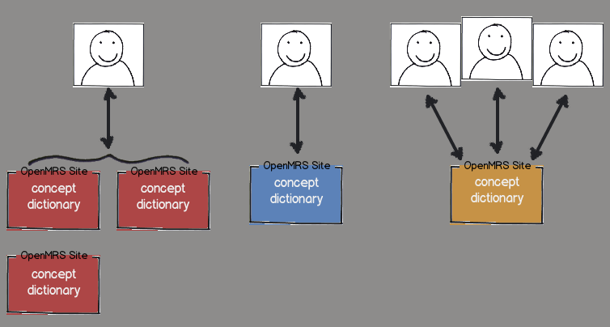
Duplicate Concepts
Notes:
Motivation

Slide 3
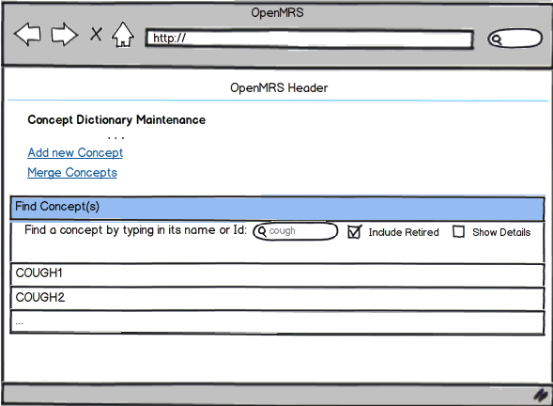
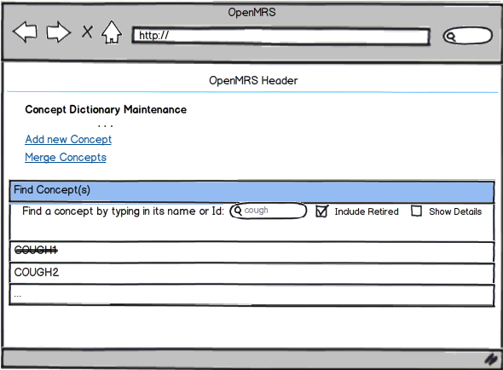
Merge Concepts

Slide 4
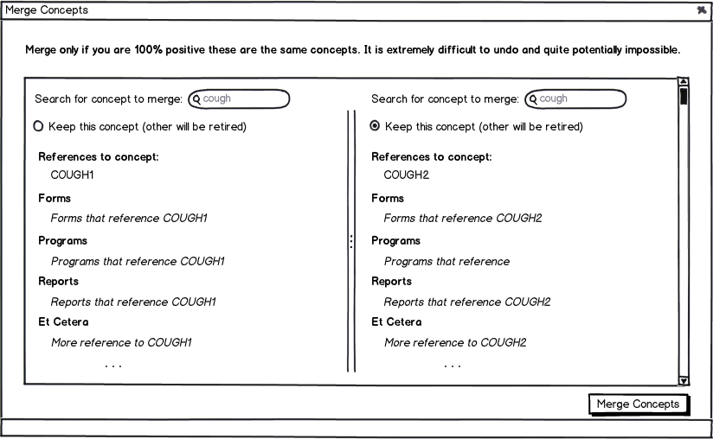
Merge Concepts Module

Slide 5
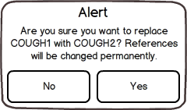
Tables being updated…
obs
drug
orders
field
program
program_workflow
program_workflow_state
person_attribute_type
Forms
reports
global_property

Slide 6
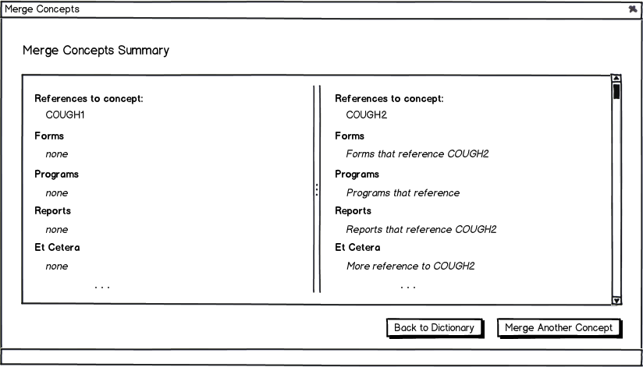
Merge Concepts Module

Slide 7
Questions
Project page:
https://wiki.openmrs.org/display/projects/Merge+Concepts+Module
Relevant tickets:
https://tickets.openmrs.org/browse/TRUNK-2351
https://tickets.openmrs.org/browse/TRUNK-293

